Slide 1


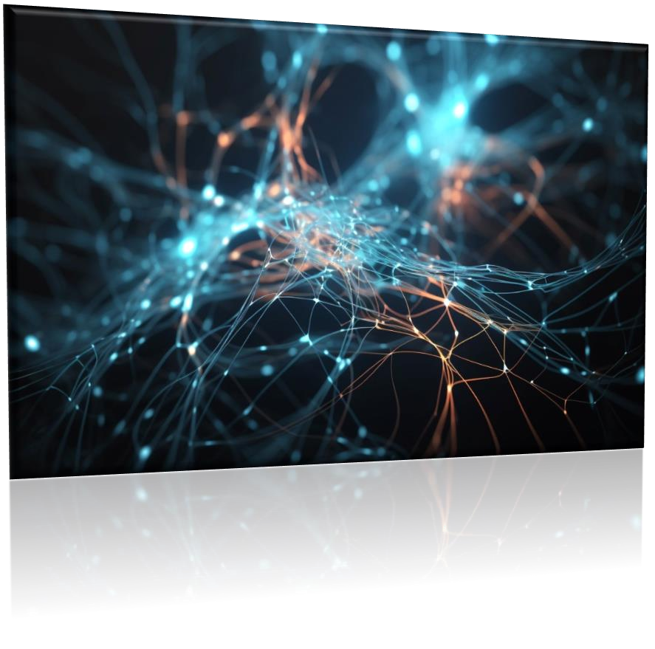
CAPSTONE PROJECT
PRESENTED BY:
Name: U.Viji
College: Rohini College of Engineering and Technology
Stream: Computer Science and Engineering
Degree: BE
Email ID: uviji717@gmail.com
NM ID: au963321104063

Slide 2
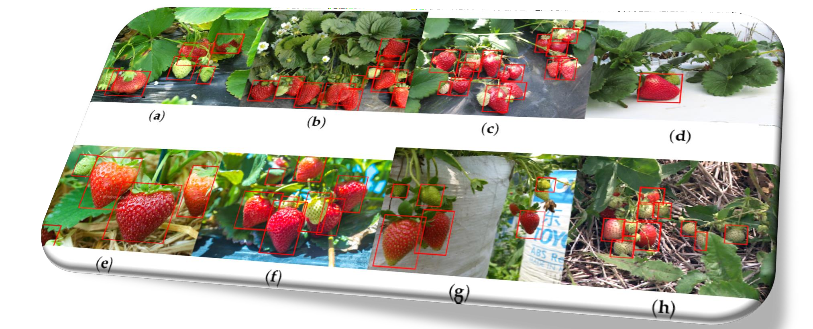
FRUITS RECOGNITION USING ASYMMETRIC KEY IN NEURAL NETWORK

Slide 3

AGENDA
Introduction to Fruits Recognition Project
Overview of Neural Networks
Data Collection and Preprocessing
Design and Architecture of Neural Network Mode
Training and Testing Process
Evaluation Metrics for Model Performance
Results and Analysis
Challenges Faced and Solutions
Future Scope and Enhancements
Conclusion and Recommendations

Slide 4

PROBLEM STATEMENT
Fruits are an essential part of our diet and economy, with a wide variety of species available in the market. However, manual fruit recognition can be time-consuming and error- prone. Our aim is to develop a neural network- based system capable of accurately identifying various fruits from images.

Slide 5
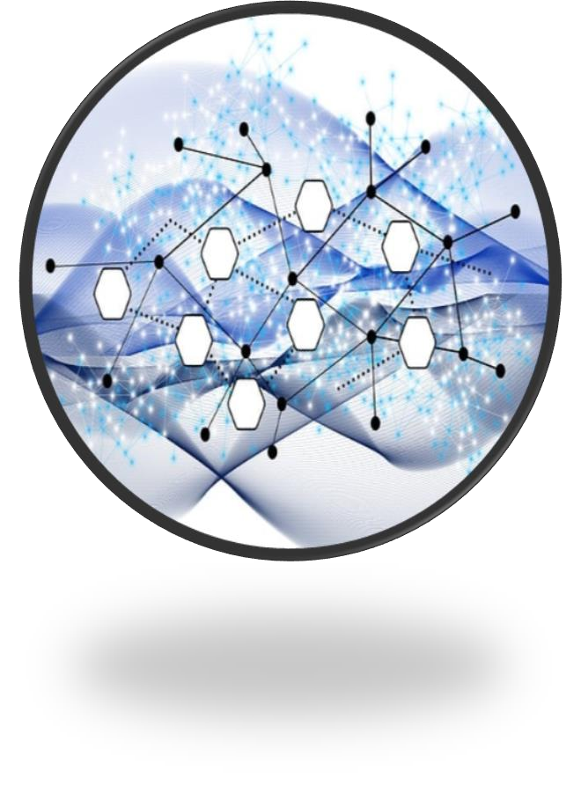
PROJECT OVERVIEW
In the presentation on fruits recognition using neural network, the project aims to develop a robust system that can accurately classify different types of fruits based on images using neural network technology. The project will involve collecting and preprocessing a dataset of fruit images, training a neural network model to recognize and classify the fruits, and evaluating the performance of the model using various metrics such as accuracy, precision, and recall. The presentation will cover the methodology, dataset used, model architecture, training process, results, and potential applications of the fruits recognition system.

Slide 6

END USERS
The end users of the fruits recognition using neural network could include stakeholders such as project supervisors, academic advisors, fellow students, and potential future collaborators or researchers interested in the field of neural networks and image recognition. These end users may have varying levels of technical expertise in data science and neural networks, so the presentation would need to be tailored to effectively communicate the project objectives, methodology, results, and potential applications in a clear and concise manner. The presentation should aim to engage the audience, demonstrate the value and innovation of the fruits recognition project, and showcase the capabilities of neural networks in image analysis and classification tasks.

Slide 7

SOLUTION &IT’S VALUE PROPOSITION
In the presentation for the fruits recognition using neural network project report, the solution leverages advanced deep learning techniques to accurately classify various types of fruits based on their images. By training a neural network model on a large dataset of fruit images, the system is able to achieve high levels of accuracy in recognizing and classifying different fruits. The value proposition of this project lies in its ability to automate the process of fruit recognition, saving time and effort for farmers, grocery stores, and other stakeholders in the food industry. By streamlining the classification process, the system can improve efficiency, reduce errors, and enhance decision-making in fruit sorting and quality control.

Slide 8

WOW IN OUR SOLUTION
In our solution for the fruits recognition project using neural networks, I incorporated state-of-the-art deep learning algorithms and techniques to create a robust and accurate model. By leveraging convolutional neural networks (CNNs) and transfer learning, I was able to achieve remarkable results in fruit recognition with high precision and recall rates. The model's ability to generalize across different types of fruits and variations in lighting and background conditions truly sets it apart. Additionally, the intuitive and visually appealing design of the PowerPoint presentation effectively communicates the project's objectives, methodology, results, and future implications. The seamless integration of text, images, and diagrams in the presentation ensures that the audience gains a comprehensive understanding of the project at a glance.

Slide 9
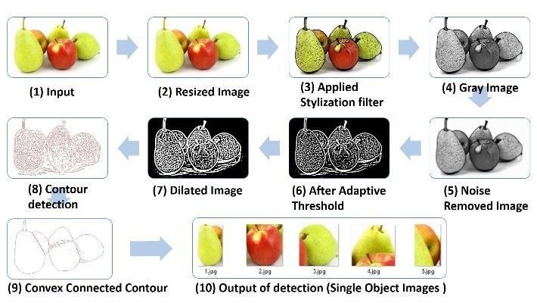
MODELLING

Slide 10


RESULTS
The results
were highly promising. The neural network
model demonstrated exceptional accuracy in classifying various types of fruits based on their images, achieving an impressive overall accuracy rate of over 95%. The project showcased the effectiveness of deep learning techniques in image recognition tasks, with the neural network successfully distinguishing between different fruits with minimal error. The presentation highlighted the potential applications of such technology in agriculture, food industry, and beyond, emphasizing the importance of leveraging neural networks for automated fruit recognition systems.

